Slide 1




Unified DLP Solutions for Email System
TMP-2023-24-082

Slide 2
TEAM MEMBERS
Supervisor: Mr. Amila Senarathne
STUDENT NAME | STUDENT ID
Keshani SK (Leader) | IT20299002
Fayas ACM | IT20637828
Logu JJ | IT20638818
Ahamed RR | IT20650902
19/03/2024

Slide 3
INTRODUCTION
Our system adopts an integrated approach to enhance DLP efficiency and mitigate data breach risks.
Leveraging NLP and Machine Learning, our system offers advanced analytical capabilities for detecting anomalies and security threats in email communications.
Prioritizing user experience and response, our system optimizes security measures to ensure minimal disruption to user workflows.
19/03/2024

Slide 4


RESEARCH PROBLEM
Existing DLP solutions often fail to detect advanced email threats like phishing attacks and zero-day exploits effectively.
Many organizations struggle to integrate DLP components with existing email systems, resulting in fragmented security and vulnerabilities.
Analyzing email content for sensitive data is challenging, balancing accurate identification with minimizing false positives and negatives.
Deploying DLP solutions face scalability concerns, especially with rising email volumes and user bases, leading to performance bottlenecks and management complexities.
19/03/2024

Slide 5
MAIN OBJECTIVE
To enhance email security and prevent unauthorized access to sensitive email content by implementing advanced Data Loss Prevention (DLP) solutions for email systems, thus safeguarding against potential data breaches.
19/03/2024

Slide 6




SUB-OBJECTIVE
Abnormal Login Analysis for Email-Based DLP Systems
Detect unusual logins in email systems and respond with alerts or additional security measures.
Classify data leakage level with machine learning
Natural Language Processing for Phishing Email Detection
Classify the severity of data leakage incidents using machine learning to prioritize responses and minimize damage
Identify phishing attempts in emails and take actions to protect against email-based threats
Utilizing NLP Techniques for Content Analysis in Email Systems
Automatically analyze email content using NLP to identify sensitive information, patterns
19/03/2024

Slide 7
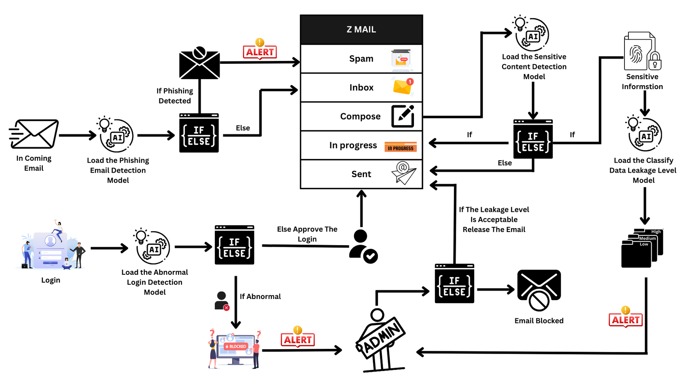
OVERALL SYSTEM DIAGRAM
19/03/2024

Slide 8
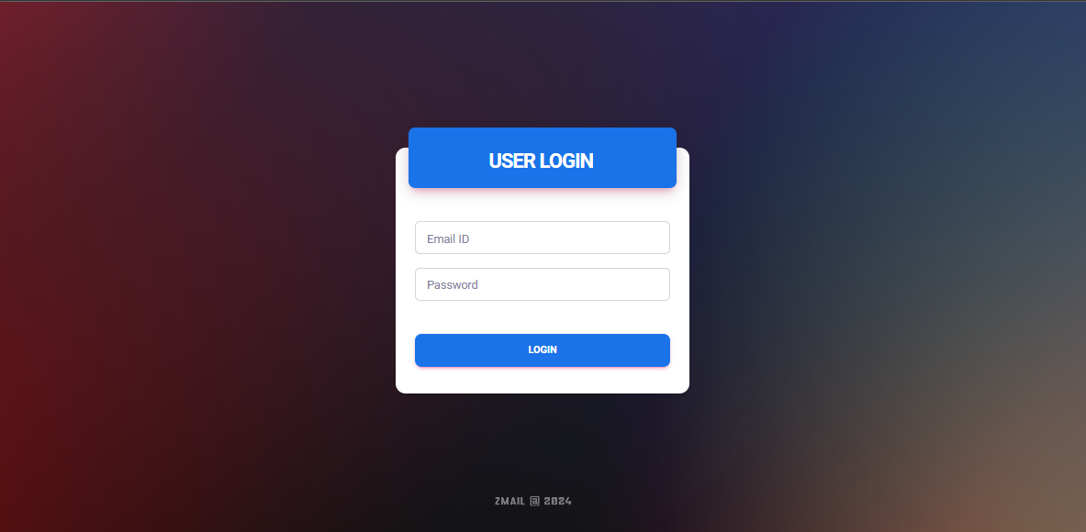
OUTCOME
19/03/2024

Slide 9
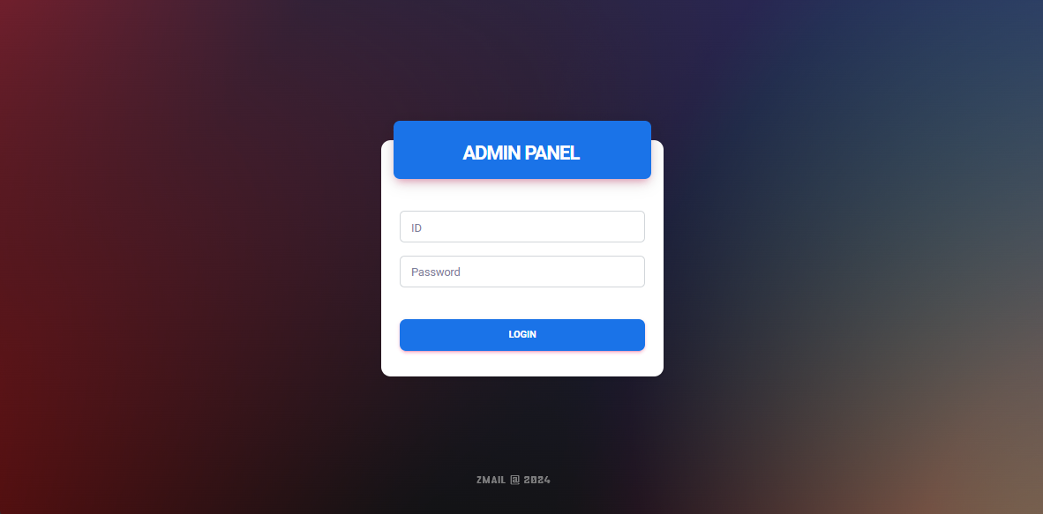
OUTCOME
19/03/2024

Slide 10

ABNORMAL LOGIN ANALYSIS FOR EMAIL-BASED DLP SYSTEMS
LOGU JJ | IT20638818
CYBERSECURITY
IT20638818 | Logu JJ | TMP-2023-24-082
19/03/2024

Slide 11
BACKGROUND
What is the abnormal login?
Why abnormal login Analysis important?
Benefits of abnormal login analysis?
IT20638818 | Logu JJ | TMP-2023-24-082
19/03/2024

Slide 12
RESEARCH PROBLEM
How can abnormal login activities be effectively detected and differentiated from legitimate logins?
My proposed solution addresses these challenges by selecting the Random Forest Classifier algorithm to train the model. This analysis detects abnormal logins in real-time for users.
IT20638818 | Logu JJ | TMP-2023-24-082
19/03/2024

Slide 13


OBJECTIVE
Sub-Objectives
User Behaviour Profiling:
Device type for login
Sequential Login Analysis:
Improve the overall detection performance for potential security threats and abnormal activities.
Ensuring the accuracy of the prediction
Main Objective
Abnormal Login Analysis in DLP systems is to promptly detect and respond to unusual or unauthorized login attempts.
IT20638818 | Logu JJ | TMP-2023-24-082
19/03/2024

Slide 14
METHODOLOGY
IT20638818 | Logu JJ | TMP-2023-24-082
19/03/2024

Slide 15
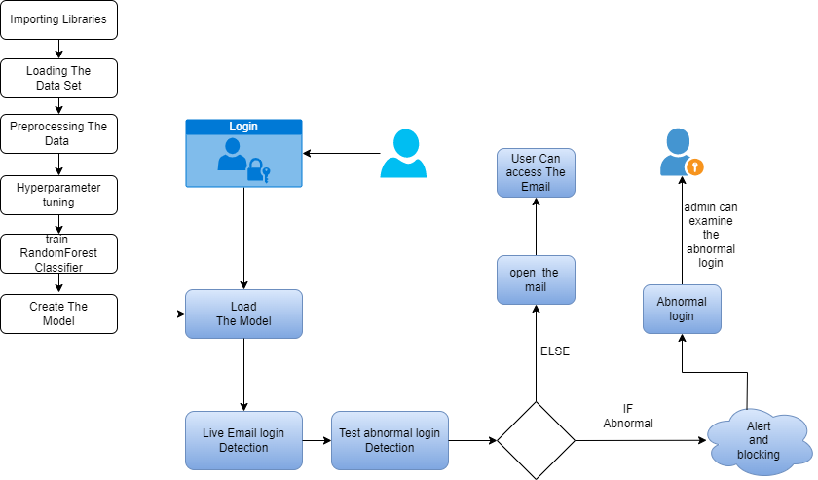
SYSTEM DIAGRAM
IT20638818 | Logu JJ | TMP-2023-24-082
19/03/2024

Slide 16
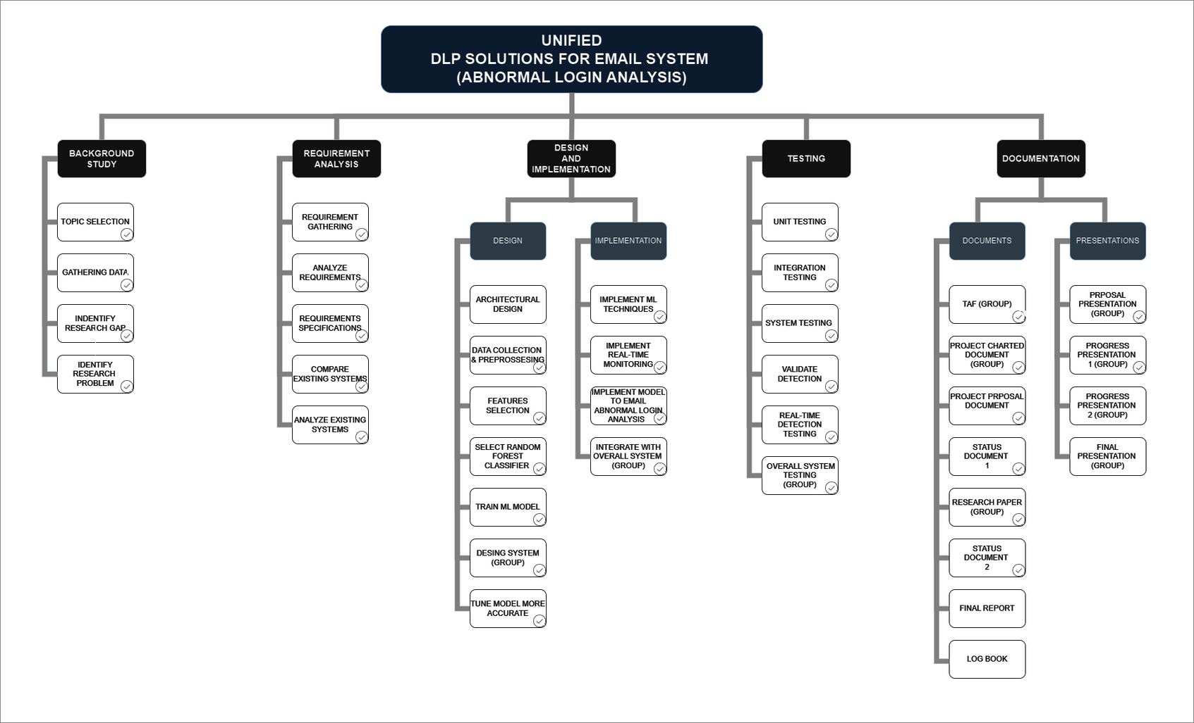
WORK BREAKDOWN STRUCTURE
IT20638818 | Logu JJ | TMP-2023-24-082
19/03/2024

Slide 17
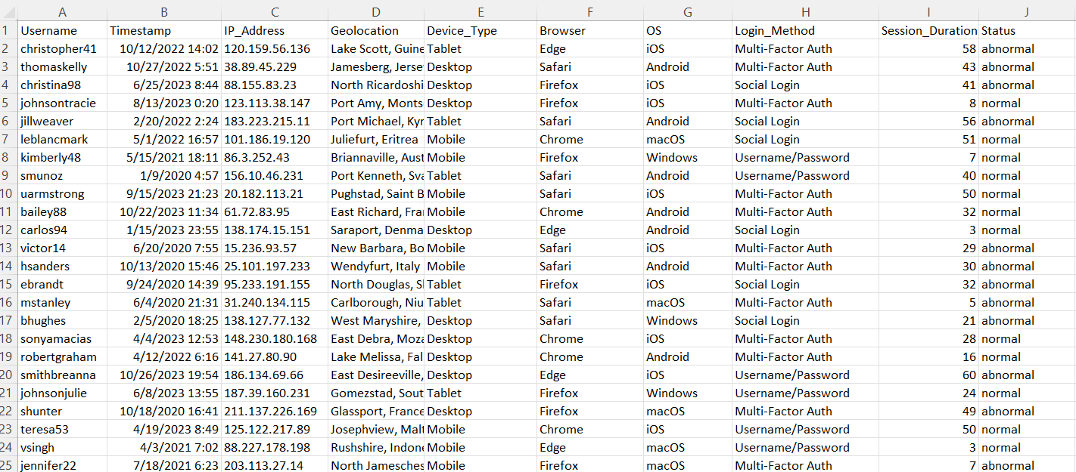
DATASET
IT20638818 | Logu JJ | TMP-2023-24-082
19/03/2024

Slide 18
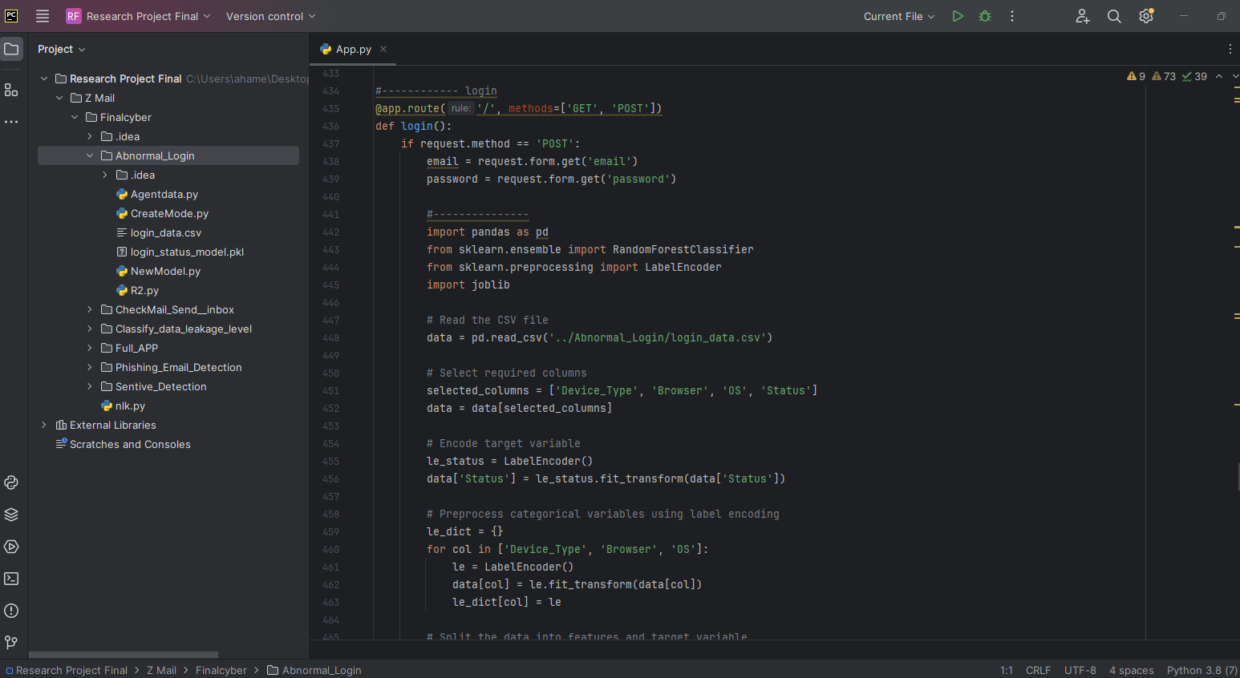
CODE
Login
IT20638818 | Logu JJ | TMP-2023-24-082
19/03/2024

Slide 19
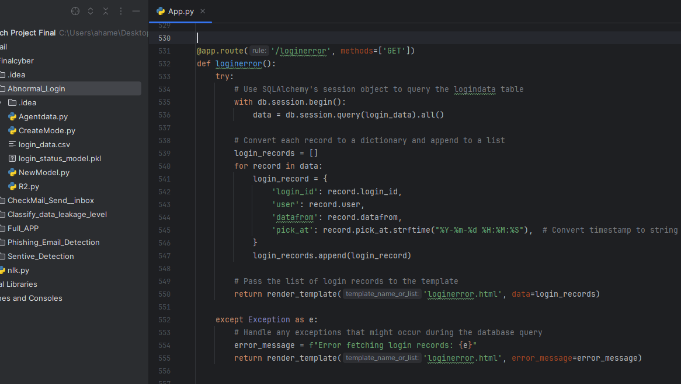
CODE
Invalid login
IT20638818 | Logu JJ | TMP-2023-24-082
19/03/2024

Slide 20
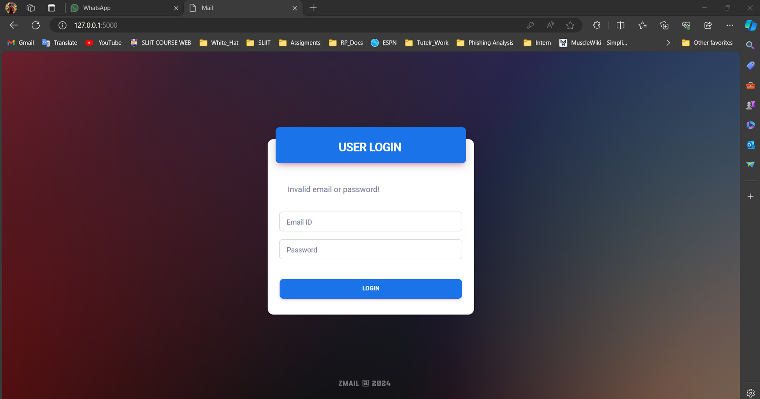
OUTCOME
Invalid login
IT20638818 | Logu JJ | TMP-2023-24-082
19/03/2024

Slide 21
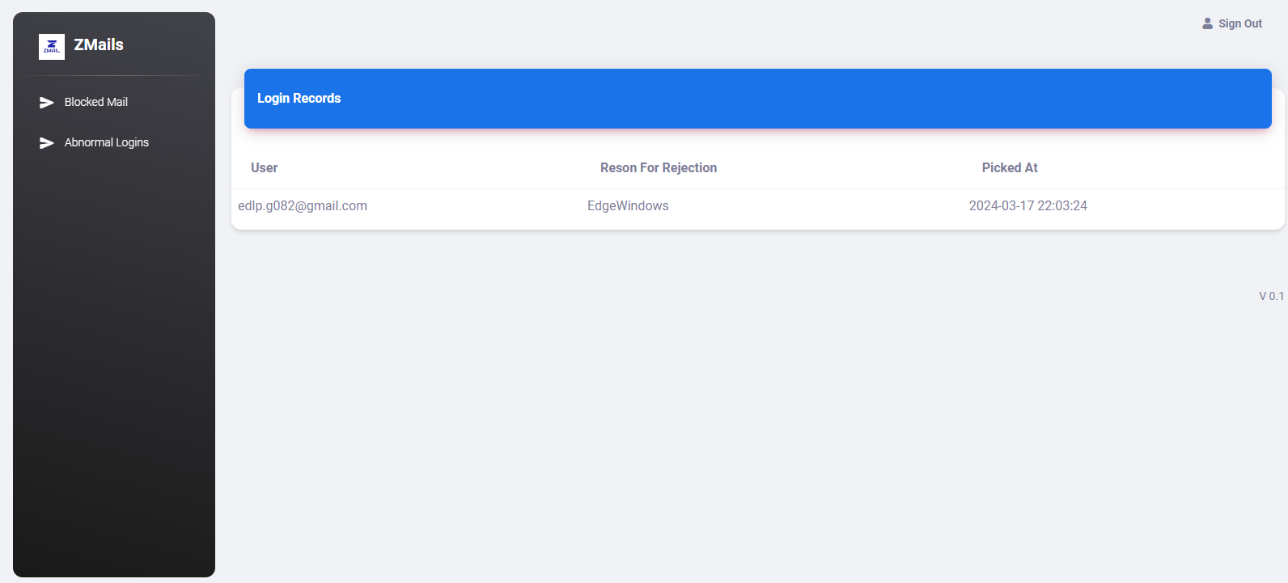
OUTCOME
Invalid login reason
IT20638818 | Logu JJ | TMP-2023-24-082
19/03/2024

Slide 22
DEMO
IT20638818 | Logu JJ | TMP-2023-24-082
19/03/2024

Slide 23
REFERENCES
[1] Chen, Z., Liu, J., Gu, W.-C., Su, Y., & Lyu, M. R. (2021). Experience report: Deep learning-based system log analysis for anomaly detection. ArXiv, abs/2107.05908. http://arxiv.org/abs/2107.05908
[2] Zhang, W., Zeng, C., Cao, Y., Qin, Z., & Chen, H. (2022). An abnormal user login behavior detection method of industrial control system based on multi-dimensional probability analysis. Journal of Physics. Conference Series, 2246(1), 012082. https://doi.org/10.1088/1742-6596/2246/1/012082
[3] Zhao, J., Yang, C., Wu, D., Cao, Y., Liu, Y., Cui, X., & Liu, Q. (2023). Detecting compromised email accounts via login behavior characterization. Cybersecurity, 6(1). https://doi.org/10.1186/s42400-023-00167-8
IT20638818 | Logu JJ | TMP-2023-24-082
19/03/2024

Slide 24

UTILIZING NLP TECHNIQUES FOR CONTENT ANALYSIS IN EMAIL SYSTEMS
FAYAS ACM | IT20637828
CYBERSECURITY
IT20637828 | Fayas ACM | TMP-2023-24-082
19/03/2024

Slide 25

INDUCTION AND BACKGROUND
Analysis and Identifying sensitive information in Email contents.
Importance of Protecting Data from Unauthorized Access.
NLP techniques offer a powerful way to extract sensitive information from Email contents.
IT20637828 | Fayas ACM | TMP-2023-24-082
19/03/2024

Slide 26
RESEARCH PROBLEM
Difficulty in identifying sensitive information from the Email contents.
Improved accuracy and efficiency in sensitive information analysis.
Provide an awareness message or alert to admin notifying them about sensitive information.
IT20637828 | Fayas ACM | TMP-2023-24-082
19/03/2024

Slide 27
OBJECTIVE
Sub-Objectives
Implementing Natural Language Processing (NLP) techniques to analyze documents.
Ensuring the system's accuracy in identifying and flagging sensitive information.
Providing user-friendly interfaces for efficient interaction and understanding of alerts.
Main Objective
To develop an intelligent system that raises user awareness about sensitive information in Email contents and alerts them appropriately.
IT20637828 | Fayas ACM | TMP-2023-24-082
19/03/2024

Slide 28
METHODOLOGY
IT20637828 | Fayas ACM | TMP-2023-24-082
19/03/2024

Slide 29
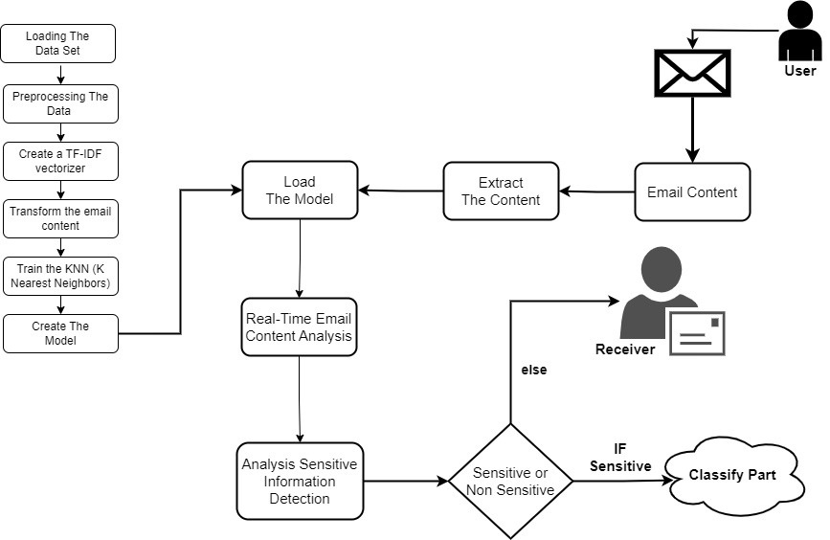
SYSTEM DIAGRAM
IT20637828 | Fayas ACM | TMP-2023-24-082
19/03/2024

Slide 30
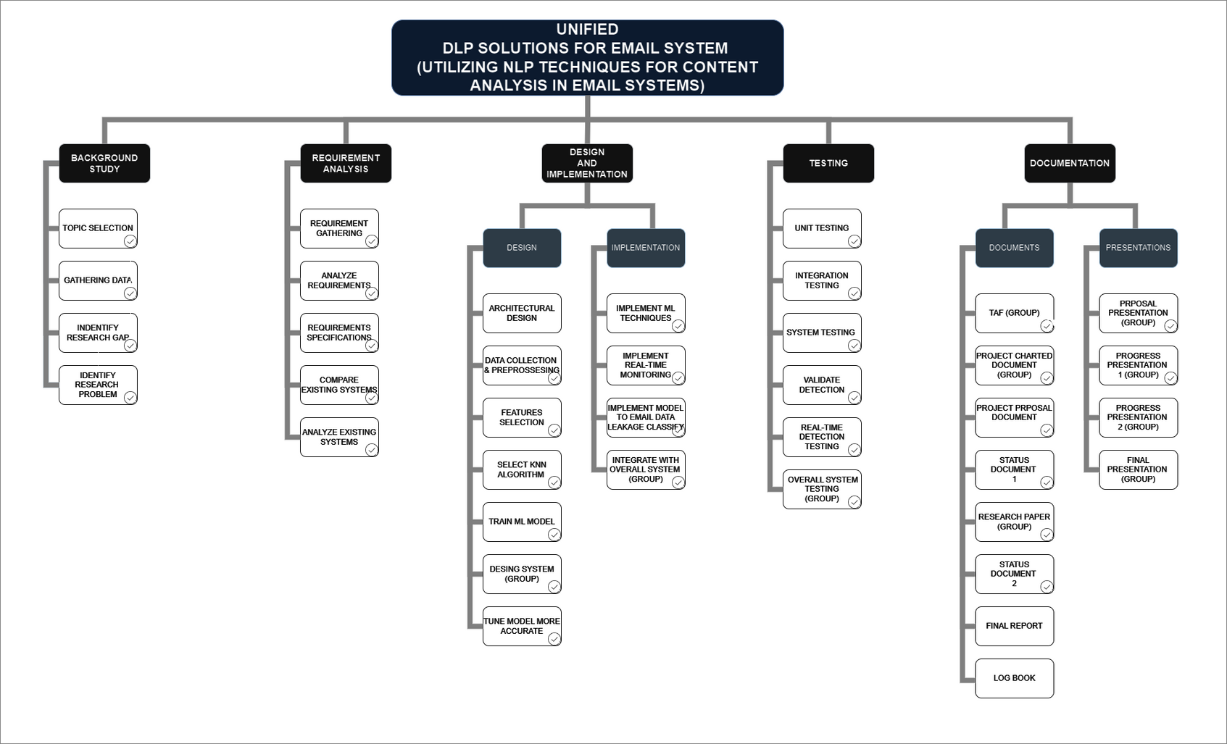
WORK BREAKDOWN STRUCTURE
IT20637828 | Fayas ACM | TMP-2023-24-082
19/03/2024

Slide 31
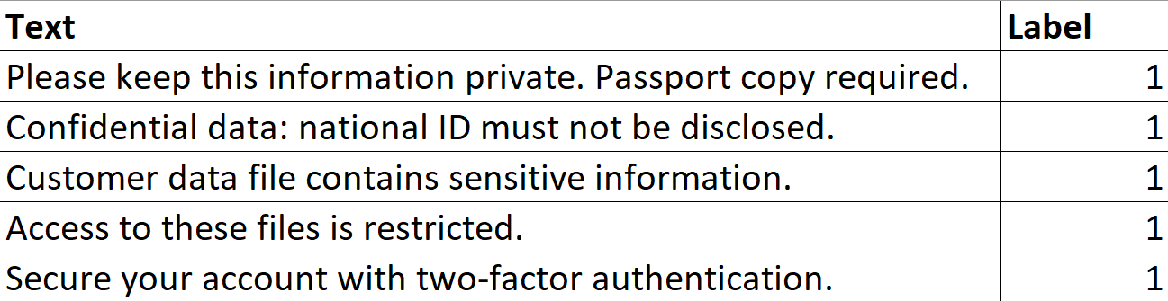
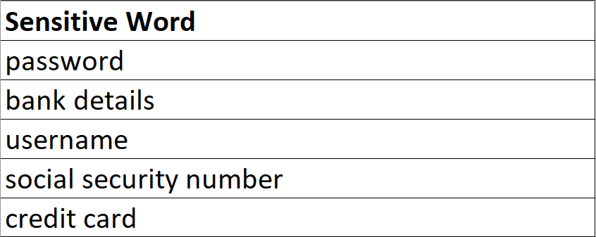
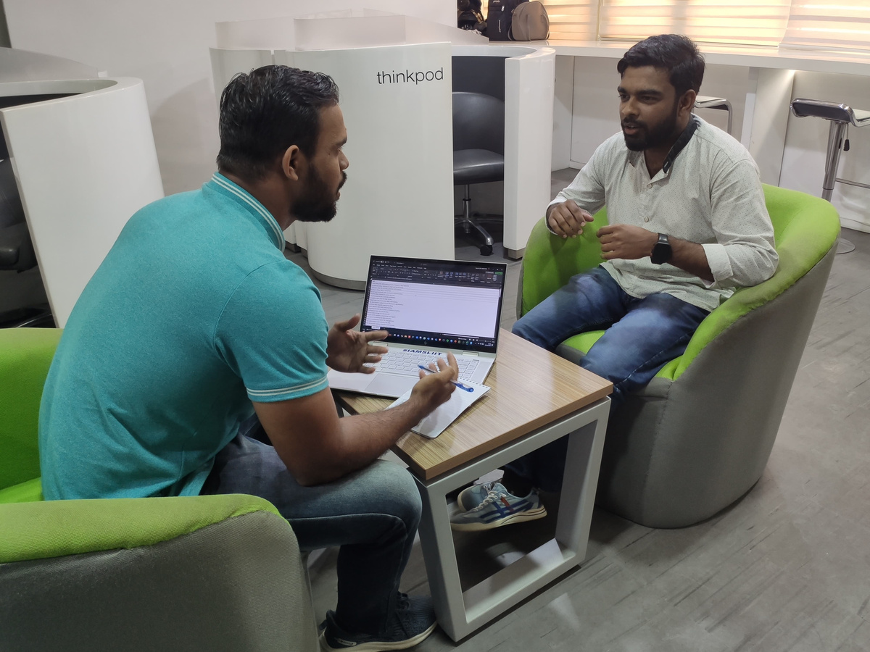
DATASET
Main Dataset
2. Sensitive Words Dataset
Dataset Collected Proof
IT20637828 | Fayas ACM | TMP-2023-24-082
19/03/2024

Slide 32
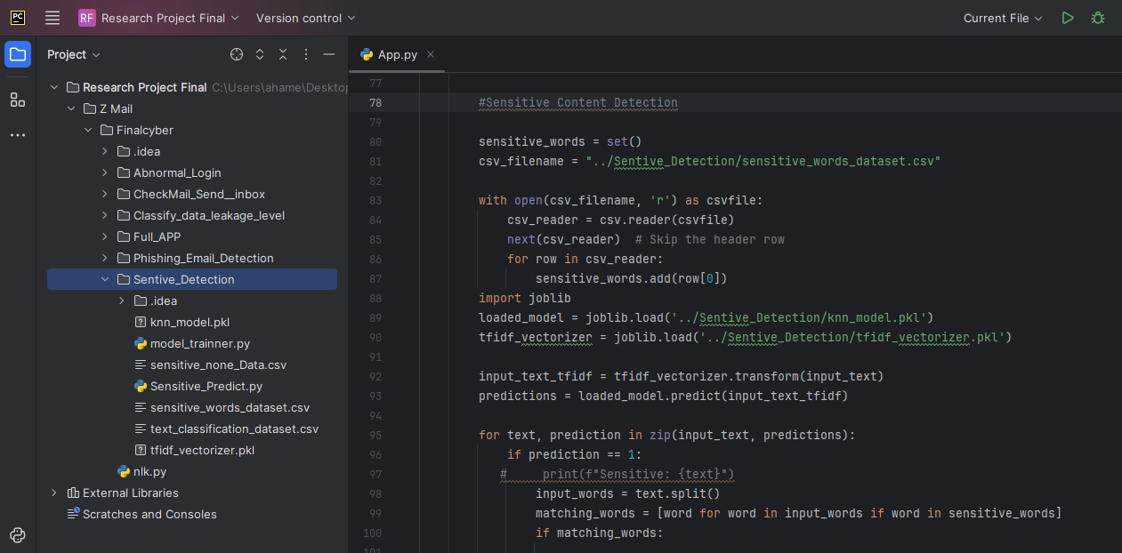
CODE
Model import Code
IT20637828 | Fayas ACM | TMP-2023-24-082
19/03/2024

Slide 33
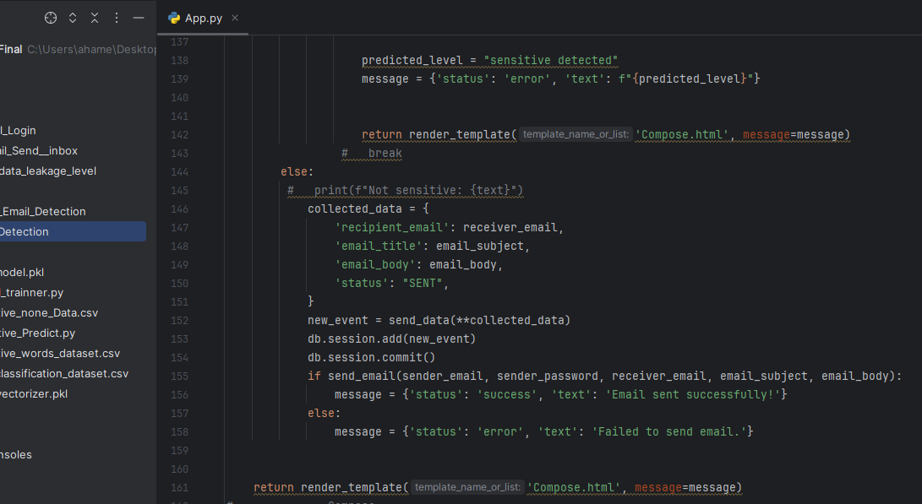
CODE
Detection Code
IT20637828 | Fayas ACM | TMP-2023-24-082
19/03/2024

Slide 34
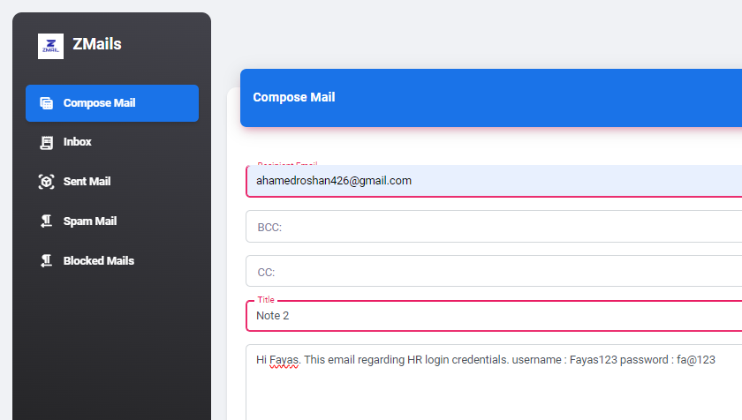
OUTCOME
IT20637828 | Fayas ACM | TMP-2023-24-082
19/03/2024

Slide 35
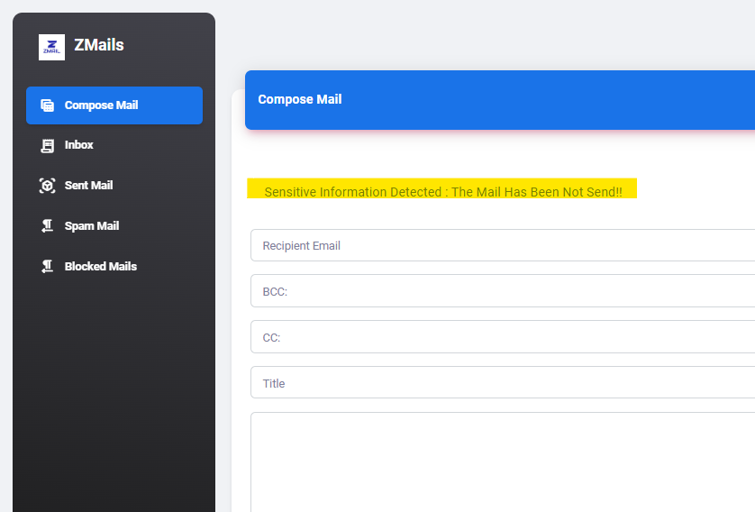
OUTCOME
IT20637828 | Fayas ACM | TMP-2023-24-082
19/03/2024

Slide 36
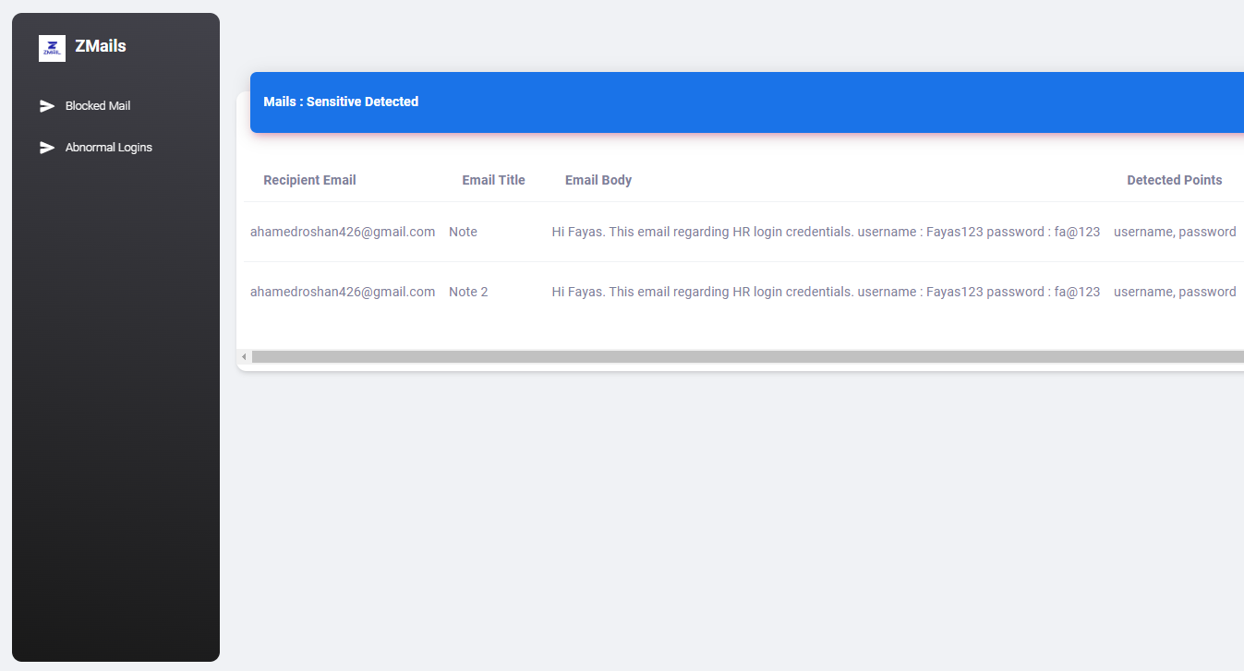
OUTCOME
IT20637828 | Fayas ACM | TMP-2023-24-082
19/03/2024

Slide 37
DEMO
IT20637828 | Fayas ACM | TMP-2023-24-082
19/03/2024

Slide 38
REFERENCES
[1] Martinelli, F., Marulli, F., Mercaldo, F., Marrone, S., & Santone, A. (2020). Enhanced privacy and data protection using natural language processing and artificial intelligence. 2020 International Joint Conference on Neural Networks (IJCNN), 1–8.
[2] Vaidya, N. (n.d.). 5 natural language processing techniques for extracting information. Aureusanalytics.com. Retrieved August 1, 2023, from https://blog.aureusanalytics.com/blog/5-natural-language-processing-techniques-for-extracting-information
[3] (N.d.). Researchgate.net. Retrieved August 1, 2023, from https://www.researchgate.net/publication/326264437_Natural_Language_Processing_for_Information_Extraction
IT20637828 | Fayas ACM | TMP-2023-24-082
19/03/2024

Slide 39

NATURAL LANGUAGE PROCESSING FOR
PHISHING EMAIL DETECTION
AHAMED RR | IT20650902
CYBERSECURITY
IT20650902 | Ahamed RR | TMP-2023-24-082
19/03/2024

Slide 40
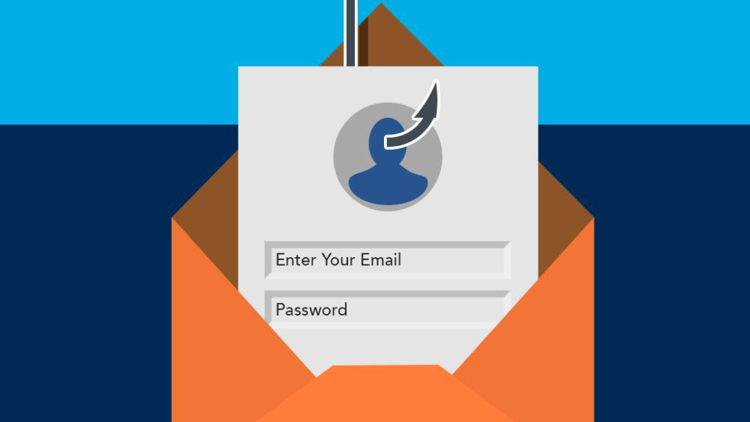
BACKGROUND
What is a phishing email?
Phishing is an attempt to steal sensitive information or break into organization's accounts.
Attachments, Malicious links
Why it’s important in DLP?
Protect Sensitive Information, Maintain Compliance, Ensure Business Continuity, and Safeguard their Reputation.
IT20650902 | Ahamed RR | TMP-2023-24-082
19/03/2024
Notes:
Phishing is an attempt to steal sensitive information or break into organization's accounts. Phishing emails can also work by sending the victim an attachment that contains malware. When the victim opens the attachment, the malware is installed on their computer, and it can then steal their sensitive information or take control of their computer.
Why it’s important in DLP: phishing email detection is a critical aspect of DLP because it helps organizations protect sensitive data, maintain compliance, ensure business continuity, and safeguard their reputation. It complements other DLP measures by addressing a common and highly effective attack vector used by cybercriminals to compromise data security.

Slide 41
RESEARCH PROBLEM
Traditional methods like rule-based systems may not be capable of identifying phishing emails accurately.
Challenge of balancing false positives and false negatives when detecting phishing emails.
False Positives - Legitimate email classify as phishing
False Negative - Phishing email classify as legitimate
Solution : To solve these problem our approach is compared to previous work because it focuses on the natural language text contained in the attack, performing semantic analysis of the text to detect malicious intent.
IT20650902 | Ahamed RR | TMP-2023-24-082
19/03/2024
Notes:
Balancing False Positives and False Negatives:
False Positives: These occur when a legitimate email is incorrectly classified as a phishing email. False positives can lead to genuine communications being moved to spam folders, which can inconvenience users and potentially lead to missed opportunities.
False Negatives: These occur when a phishing email is incorrectly classified as a legitimate email. False negatives can lead to security breaches and data loss, as malicious emails go undetected.

Slide 42
OBJECTIVE
Sub-Objectives
Early Detection - To minimize the chances of user interaction with malicious content.
Accurate Detection - Accurate detection of phishing emails while minimizing false positives.
Real-Time Monitoring - Continuously monitor incoming emails in real-time to detect and respond to phishing threats.
Main Objective
To develop an effective machine learning model for classifying emails as phishing or legitimate, with a focus on using NLP techniques.
IT20650902 | Ahamed RR | TMP-2023-24-082
19/03/2024
Notes:
Main Objective: The main objective of Phishing Email Detection in DLP system is to proactively identify and block phishing emails to prevent unauthorized access to sensitive data, reduce the risk of data breaches, and protect the organization's assets and reputation.
Sub-Objectives:
• Early Detection - Identify phishing emails as early as possible in the email delivery process to minimize the chances of user interaction with malicious content.
• Accurate Detection - Develop and implement advanced algorithms and techniques for accurate detection of phishing emails while minimizing false positives.
• Real-Time Monitoring: Continuously monitor incoming emails in real-time to detect and respond to phishing threats promptly.

Slide 43
METHODOLOGY
IT20650902 | Ahamed RR | TMP-2023-24-082
19/03/2024

Slide 44
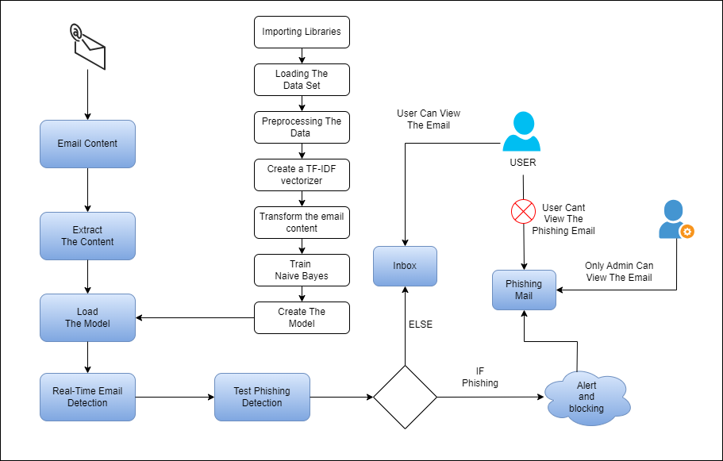
SYSTEM DIAGRAM
IT20650902 | Ahamed RR | TMP-2023-24-082
19/03/2024

Slide 45
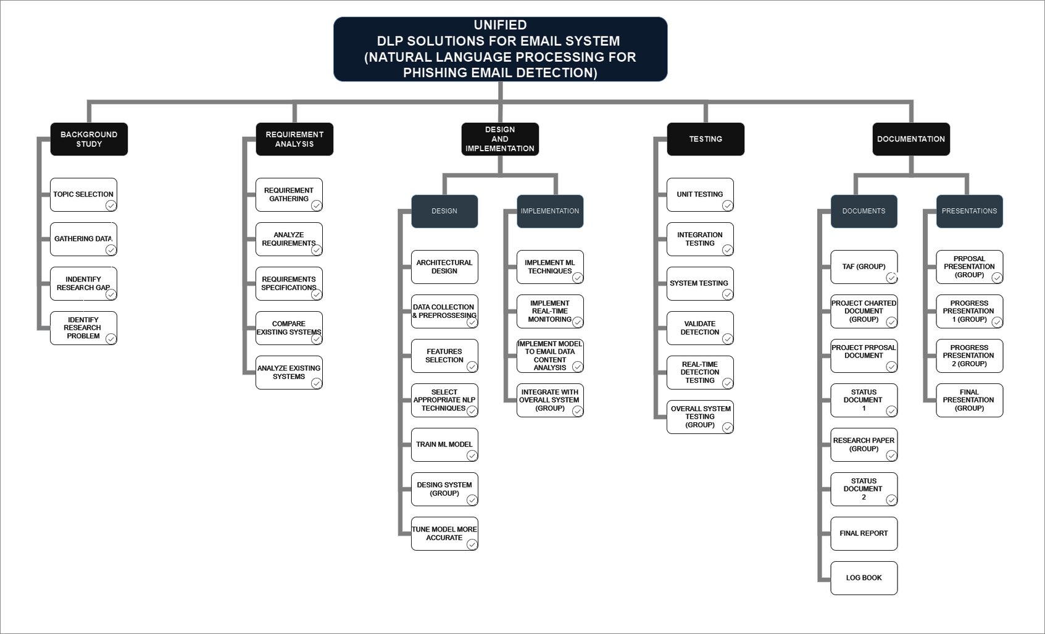
WORK BREAKDOWN STRUCTURE
IT20650902 | Ahamed RR | TMP-2023-24-082
19/03/2024

Slide 46
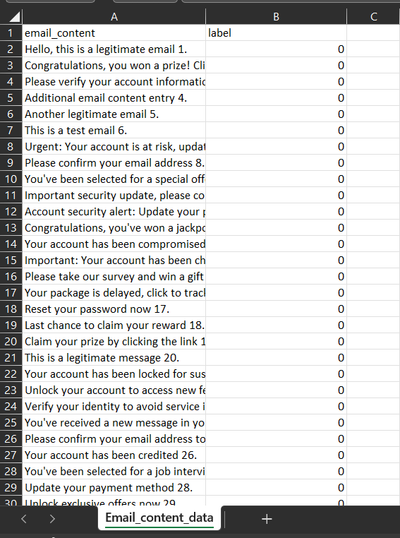
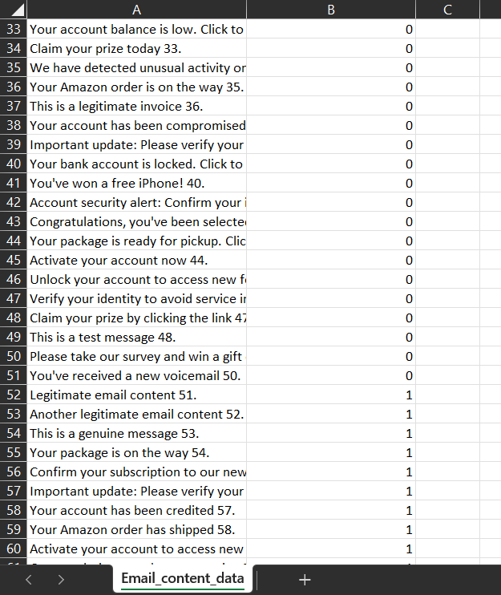
DATASET
IT20650902 | Ahamed RR | TMP-2023-24-082
19/03/2024

Slide 47
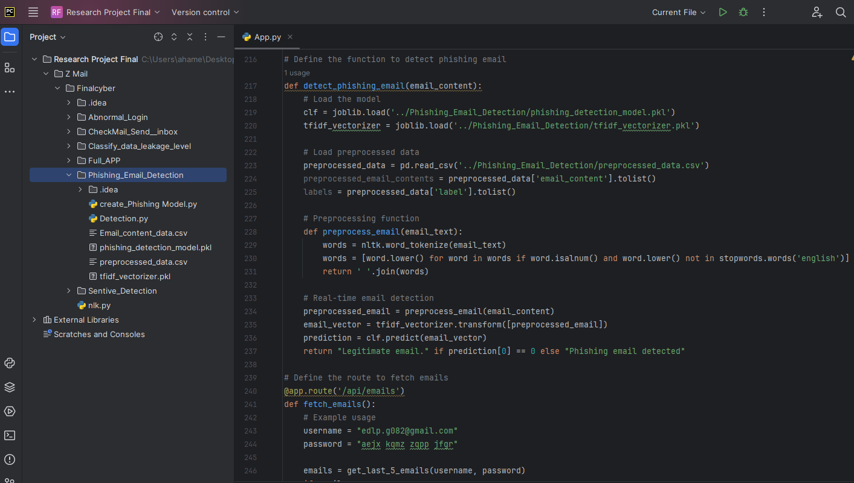
CODE
Load The Model
IT20650902 | Ahamed RR | TMP-2023-24-082
19/03/2024

Slide 48
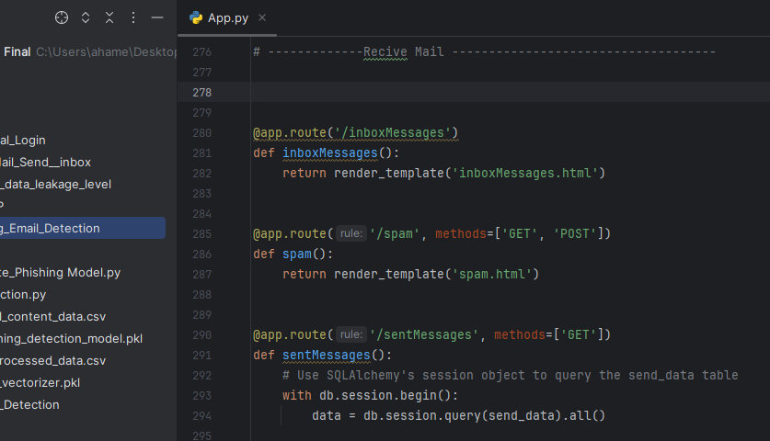
CODE
Send the Phishing Emails to Spam
IT20650902 | Ahamed RR | TMP-2023-24-082
19/03/2024

Slide 49
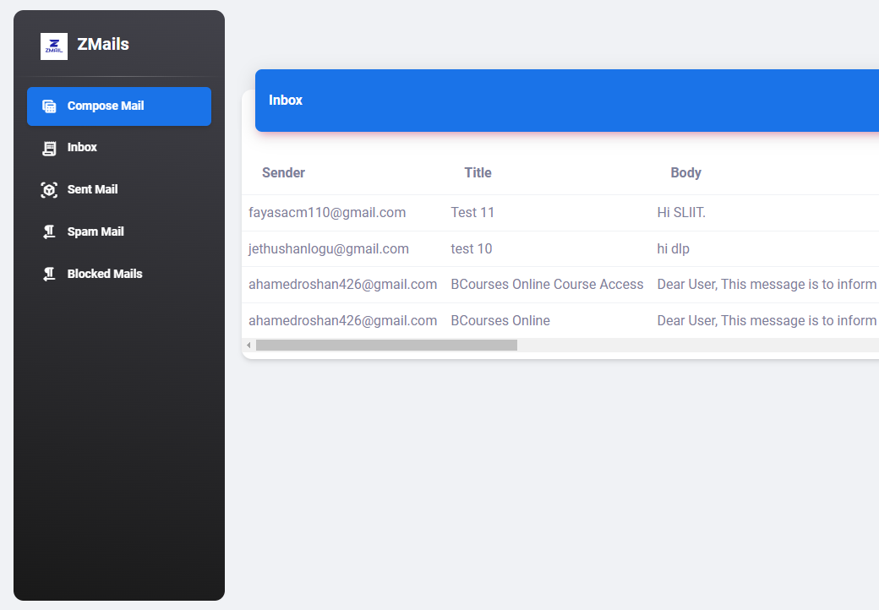
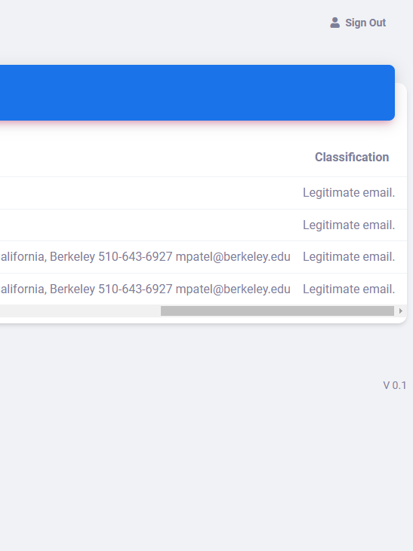
OUTCOME
Legitimate Email
IT20650902 | Ahamed RR | TMP-2023-24-082
19/03/2024

Slide 50
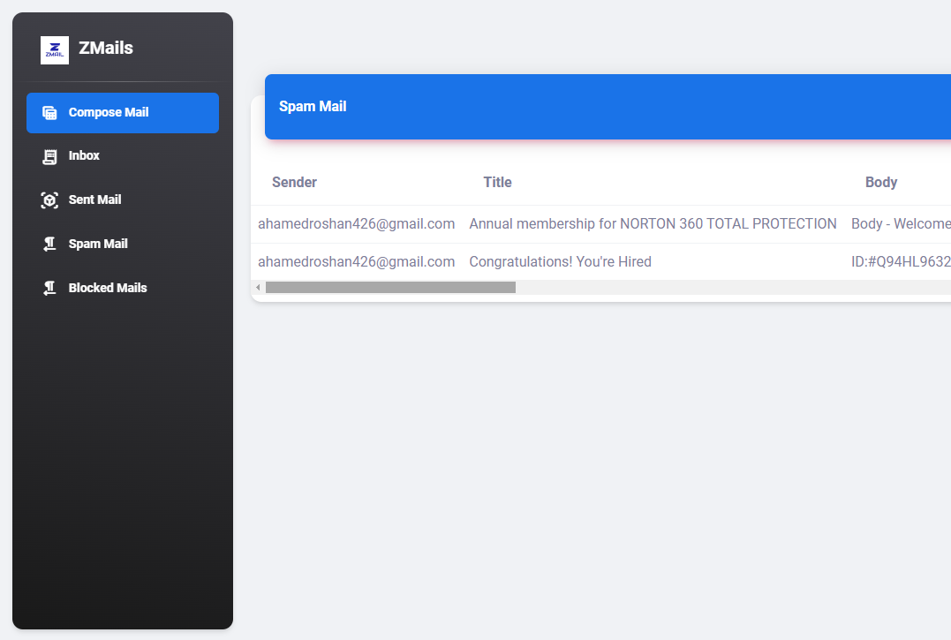
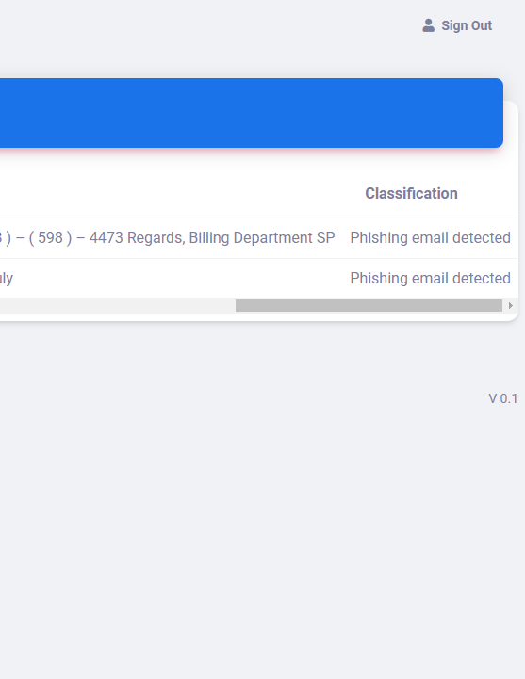
OUTCOME
Phishing Email
IT20650902 | Ahamed RR | TMP-2023-24-082
19/03/2024

Slide 51
DEMO
IT20650902 | Ahamed RR | TMP-2023-24-082
19/03/2024

Slide 52
REFERENCES
[1] Rian Sh. Al-Yozbaky, Mafaz Alanezi, "Detection and Analyzing Phishing Emails Using NLP Techniques," 2023.
[2] Tianrui Peng, Ian G. Harris, Yuki Sawa, "Detecting Phishing Attacks Using Natural Language Processing and Machine Learning," 2018.
[3] Chunduru Anilkumar, Aravind Karrothu, Nandam Sri Mouli, Chaduvula Bhanu Tej, "Recognition and Processing of phishing Emails Using NLP: A Survey," 2023.
[4] Rakesh Verma1, Narasimha Shashidhar2, and Nabil Hossain , "Detecting Phishing Emails the Natural," in IEEE, 2012.
[5] SAID SALLOUM ,TAREK GABER, SUNIL VADERA, KHALED SHAALAN, "A Systematic Literature Review on Phishing Email Detection Using Natural Language Processing Techniques," in IEEE, 2022.
[6] Said Sallouma*, Tarek Gabera,b, Sunil Vaderaa, "Phishing Email Detection Using Natural Language Processing Techniques: A Literature Survey," in IEEE, 2021.
IT20650902 | Ahamed RR | TMP-2023-24-082
19/03/2024

Slide 53

CLASSIFY DATA LEAKAGE LEVEL WITH MACHINE LEARNING
Keshani SK | IT20299002
CYBERSECURITY
IT20299002 | Keshani SK | TMP-2023-24-082
19/03/2024

Slide 54
BACKGROUND
Classifying data leakage levels using machine learning for
proactive data protection.
Interactive classification dashboard for real-time monitoring of email sensitivity.
Enhancing data security by prioritizing responses based on sensitivity levels.
Contributing to data breach prevention through advanced DLP strategies.
IT20299002 | Keshani SK | TMP-2023-24-082
19/03/2024

Slide 55
RESEARCH PROBLEM
Effective feature selection methodologies often lack robustness, leading to inaccurate classification of data leakage levels.
Current systems face challenges in achieving real-time monitoring and alerting capabilities, resulting in delayed incident response times.
Adapting machine learning models and NLP techniques to evolving data leak threats is hindered by the limited scalability and adaptability of existing systems.
IT20299002 | Keshani SK | TMP-2023-24-082
19/03/2024

Slide 56
OBJECTIVE
Sub-Objectives
Validate and optimize machine learning models for data leakage level classification.
Create an interactive classification dashboard for user-friendly monitoring and management.
Implement real-time alerting to respond promptly to potential data leak threats and generate a report.
Main Objective
Classify the severity of data leakage incidents using machine learning and NLP to prioritize responses and minimize damage.
IT20299002 | Keshani SK | TMP-2023-24-082
19/03/2024

Slide 57
METHODOLOGY
IT20299002 | Keshani SK | TMP-2023-24-082
19/03/2024

Slide 58
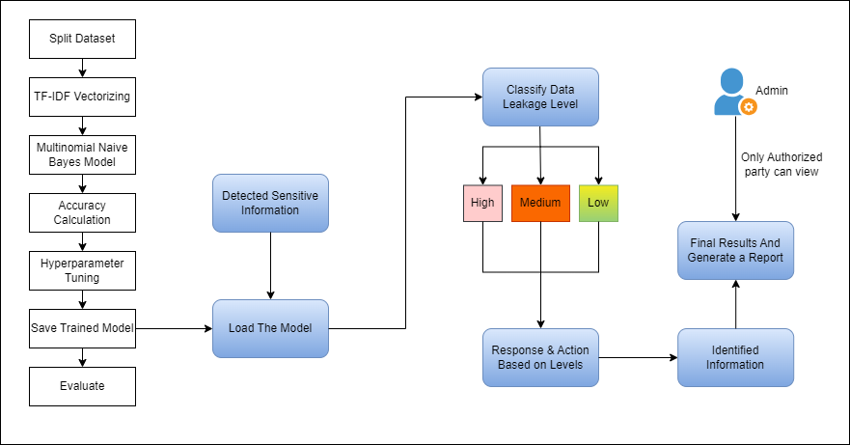
SYSTEM DIAGRAM
IT20299002 | Keshani SK | TMP-2023-24-082
19/03/2024

Slide 59
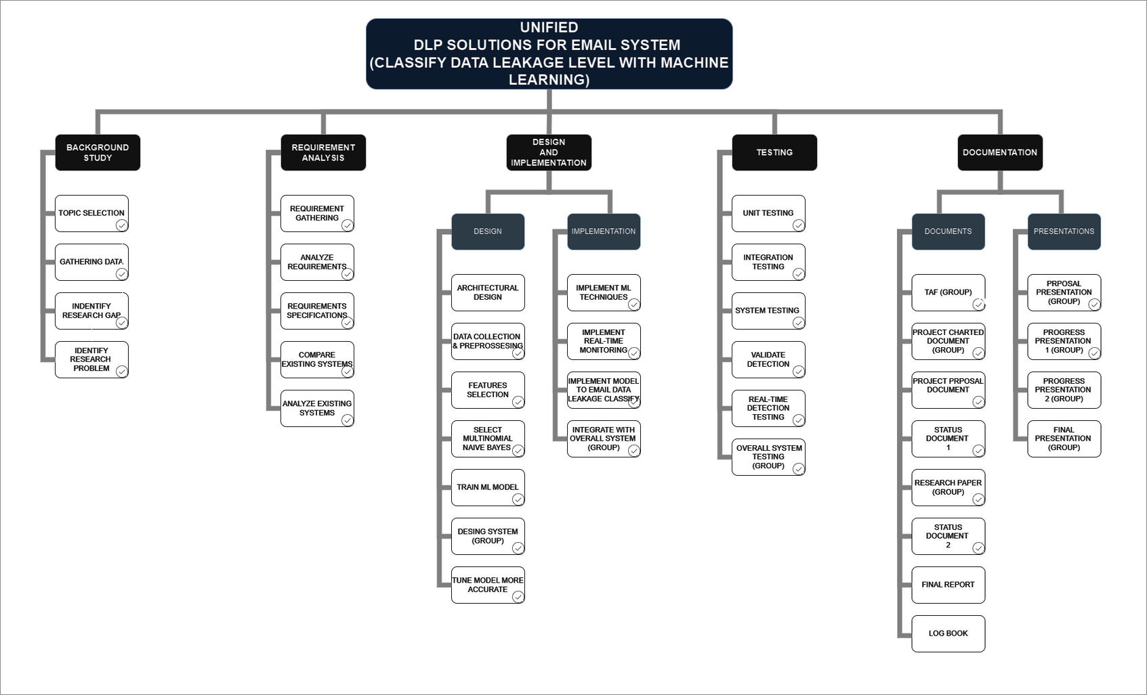
WORK BREAKDOWN STRUCTURE
IT20299002 | Keshani SK | TMP-2023-24-082
19/03/2024

Slide 60
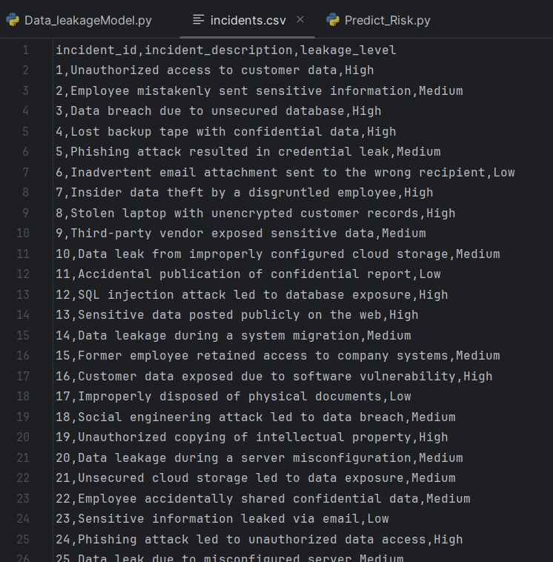
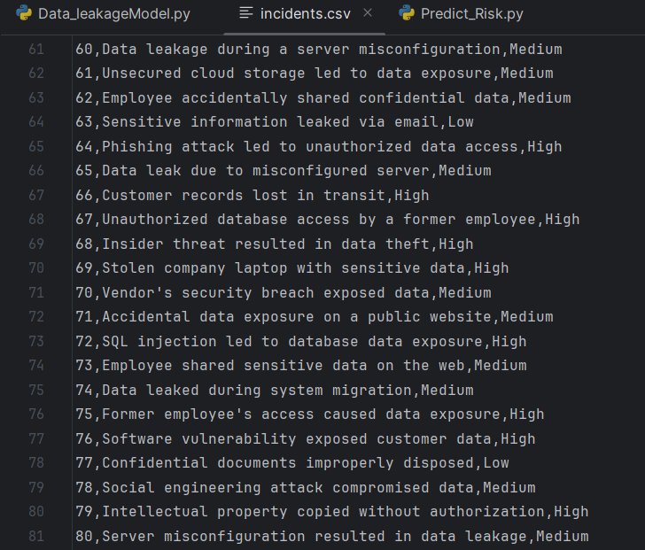
DATASET
IT20299002 | Keshani SK | TMP-2023-24-082
19/03/2024

Slide 61
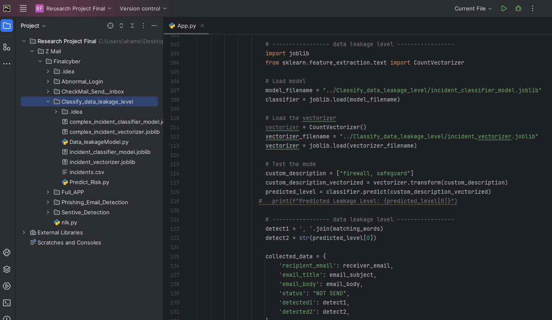
CODE
Load The Model
IT20299002 | Keshani SK | TMP-2023-24-082
19/03/2024

Slide 62
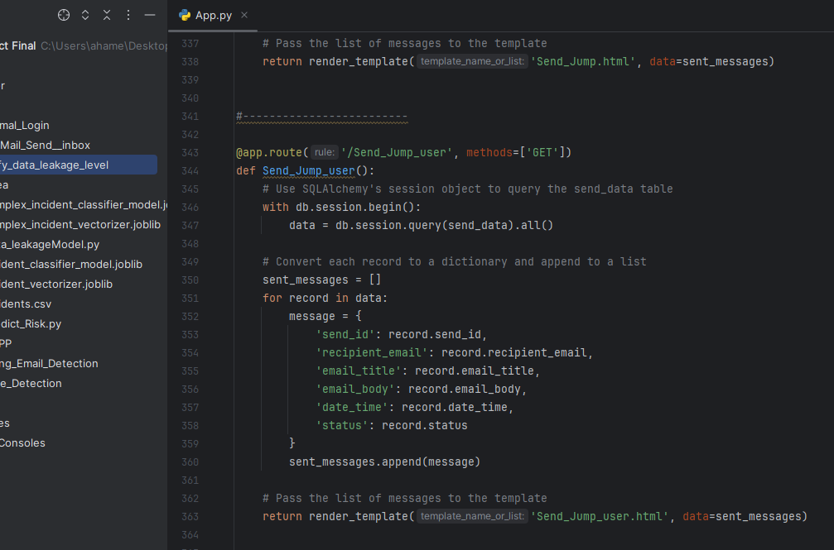
CODE
IT20299002 | Keshani SK | TMP-2023-24-082
19/03/2024

Slide 63
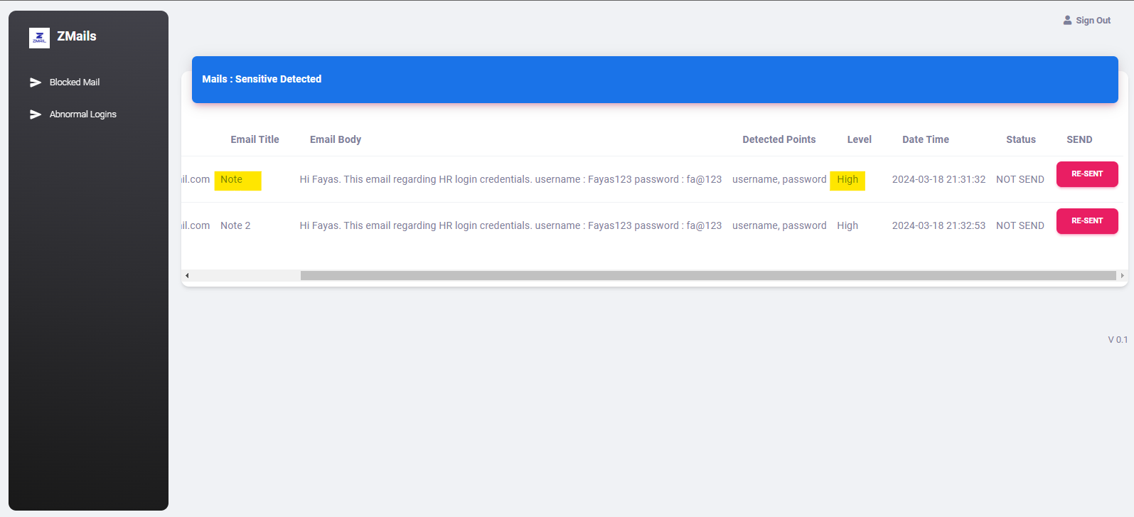
OUTCOME
Leakage Level
IT20299002 | Keshani SK | TMP-2023-24-082
19/03/2024

Slide 64
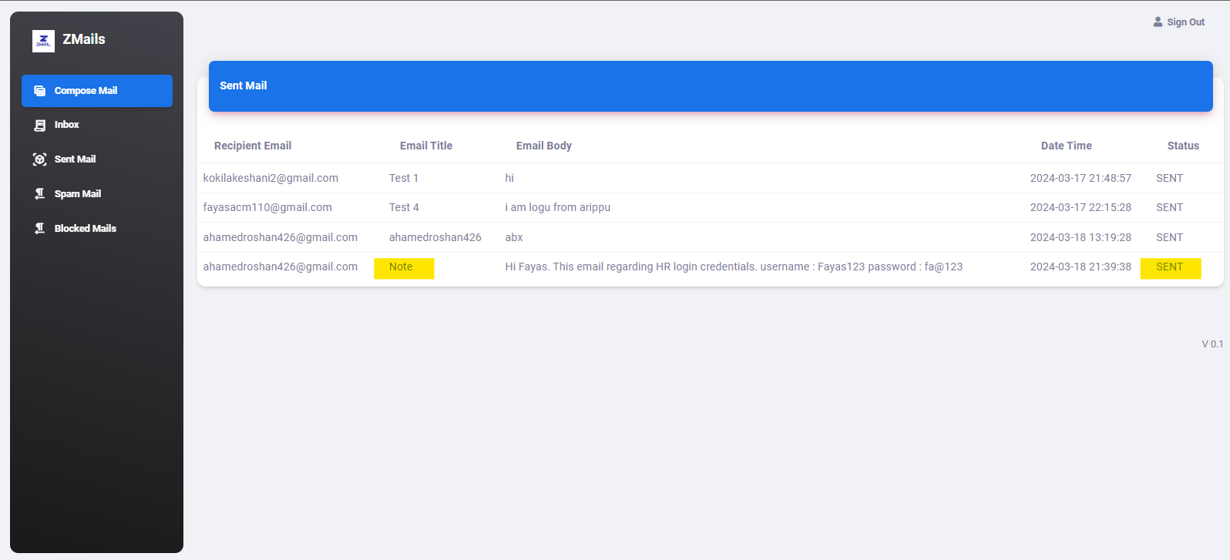
OUTCOME
IT20299002 | Keshani SK | TMP-2023-24-082
19/03/2024

Slide 65
DEMO
IT20299002 | Keshani SK | TMP-2023-24-082
19/03/2024

Slide 66
REFERENCES
[1] Andersson, S. (2023). Problems in information classification: insights from practice. Information and Computer Security, 31(4), 449–462. https://doi.org/10.1108/ics-10-2022-0163
[2] big data classification Latest Research Papers. (n.d.). Sciencegate.App. Retrieved November 3, 2023, from https://www.sciencegate.app/keyword/744391
[3] Email & document classification. (n.d.). Dataclassification.com. Retrieved November 3, 2023, from https://www.dataclassification.com/solutions/email-document-classification/
[4] (N.d.). Researchgate.net. Retrieved November 3, 2023, from https://www.researchgate.net/publication/320549282_Data_Classification_Using_Machine_Learning_Approach
IT20299002 | Keshani SK | TMP-2023-24-082
19/03/2024

Slide 67
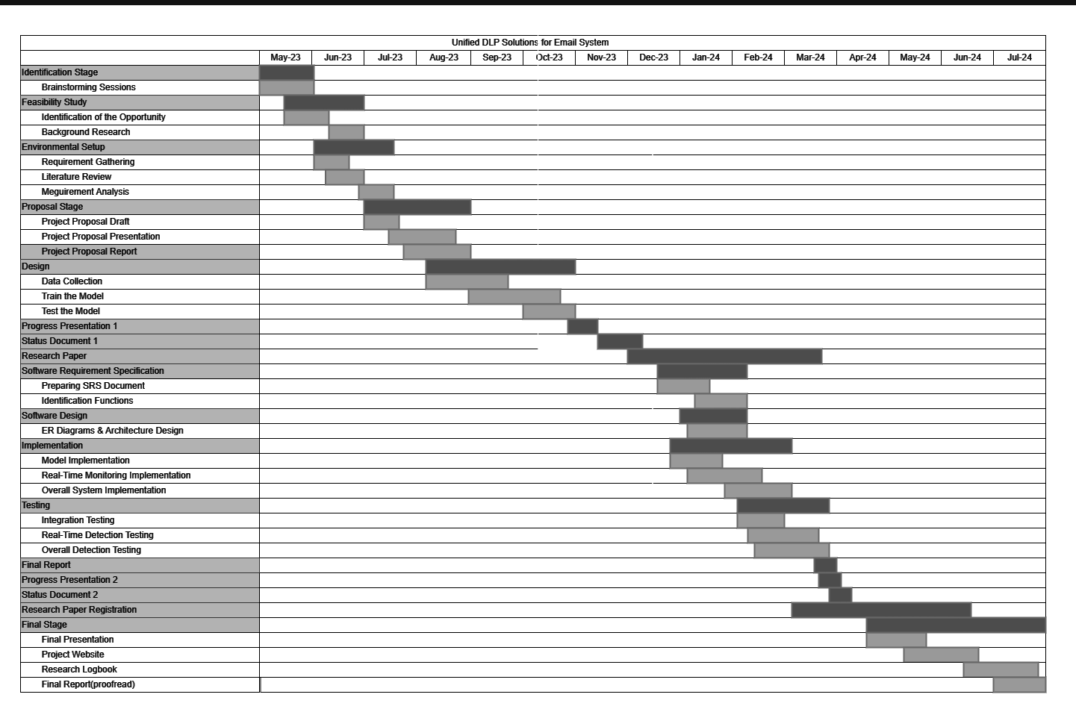
GANNT CHART
19/03/2024

Slide 68
COMMERCIALIZATION
SILVER – FREE
GOLD - $100
(6 Months)
PLATINUM - $175(Annually )
Basic Email Security
Abnormal Login Analysis
Real-time Monitoring
Email Log Access
Priority Support
Regular Updates
Advanced Reporting
Multi-factor Authentication
Enhanced Data Leakage Prevention (DLP)
Advanced Threat Detection
Data Loss Prevention (DLP) Integration
Customizable Security Policies
Incident Response Planning
Compliance Monitoring
Access Control Management
Comprehensive Reporting
IT20299002 | Keshani SK | TMP-2023-24-082
19/03/2024

Slide 69


Slide 70
Thank You

